Slide 1

ECTE 250 Proposals
ECTE 250 (Engineering Design and Management 2 )
GROUP A:
Habiba Abdelsamie
Amr Assar
Ahmed Aburas
Ibrahim Elbarbary

Slide 2

Table of Contents
Introduction
Proposal One
Introduction
Mechanism
Sustainability
Budget
Proposal Two
Introduction
Mechanism
Sustainability
Budget

Slide 3

Introduction
Our theme was Reduce, Reuse, Recycle so we decided to look around and see what is some products we use daily and how we can make them more sustainable

Slide 4
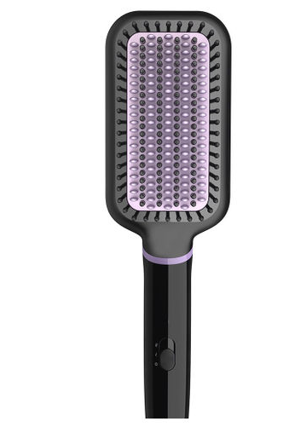
Hair Styling Brush (Idea one)
A brush that helps to make sure your hair is healthy as well as being sustainable
For all types of hair with different functionalities
As well as keeping track of all the data using your phone

Slide 5
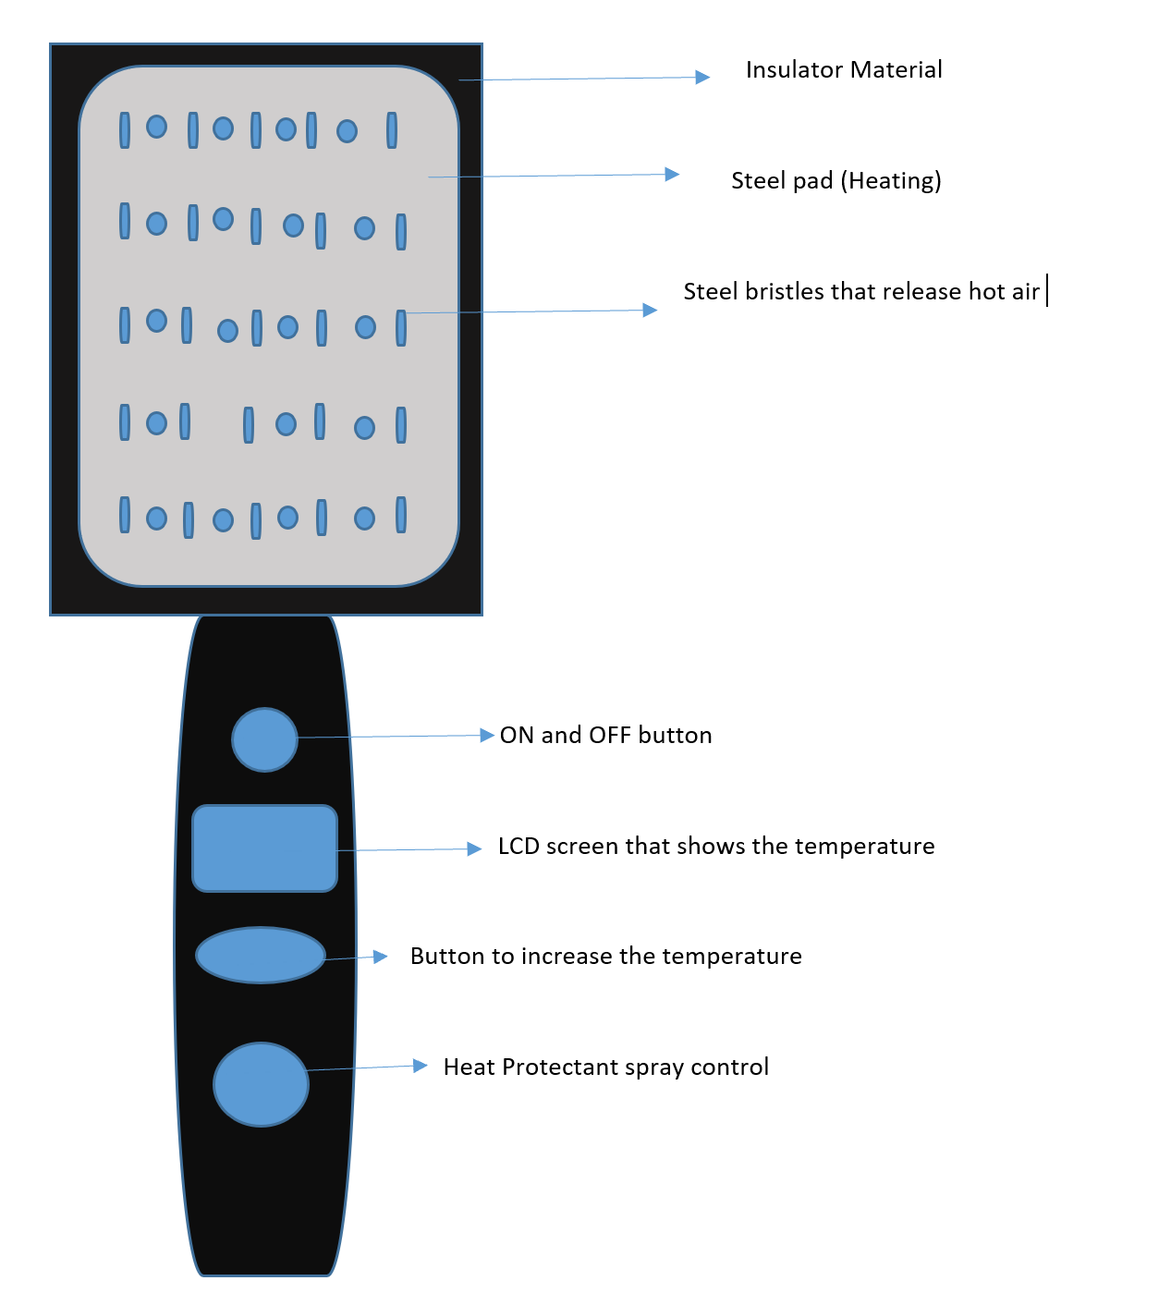
Mechanism
Our brush will take care of hair by
Having a heater to help straighten hair
Bristles and the holes that will secrete the hair protectant oil.
A rubber layer will be placed over the brush so it can be cleaned easily after use.
LCD screen and buttons used to turn on and as well to control the heat temperature
While connected to the internet to give you different statistics

Slide 6
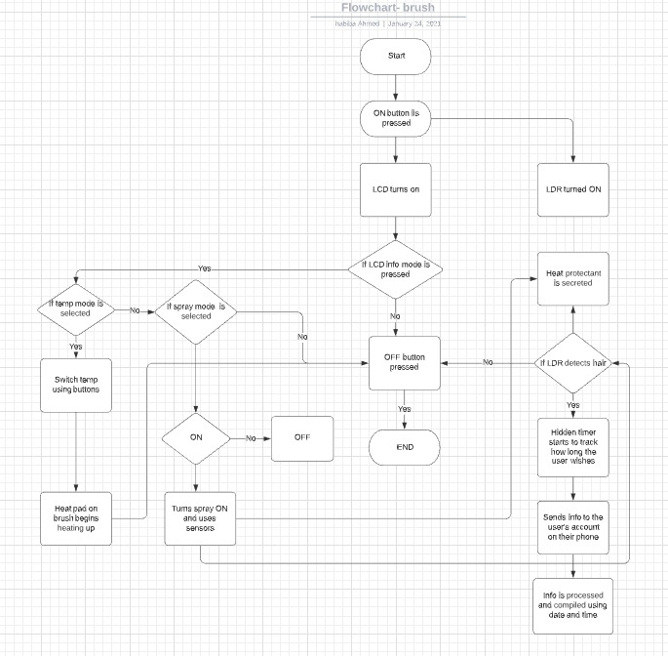
Mechanism

Slide 7
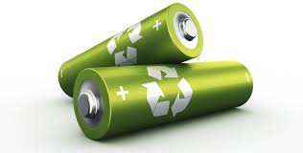
Sustainability
The brush will use
Rechargeable batteries
A solar panel to help charge as well
Charging dock
Steel bristles instead of metal as it’s a cheaper alternative

Slide 8
Budget
Item Name | Price(AED) | Total(AED)
Manufacturing costs (Buttons, Materials) | 3.68-12.88
LDRs | 12-15
Wireless Receptor | 12-20
LCD Screen (cheapest) | 30-150
 |  | 58.5 – 197.88
Budget Breakdown

Slide 9

Rotating Solar Panels (Idea Two)
A rotating Solar Panel that maximizes the amount of energy being taken and used by scanning the horizon for the sun.
This way the highest energy capacity will be used
This way the its more efficient and smarter

Slide 10
Sustainability
With solar energy being the best renewable energy source solar panel is the smartest way to stay sustainable
Having the solar panel rotate we will have a way more efficient solar panel

Slide 11
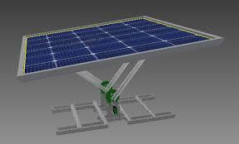
Mechanism
The solar panel will have a motor so it rotates until it detects the highest voltage in which it will stop and start charging.
The battery will charge, and the sensor be attached when it reaches full charge will turn off the whole system,
As well as connecting to the internet to send data that it has been fully charged and we can put a new empty battery in place to charge.

Slide 12
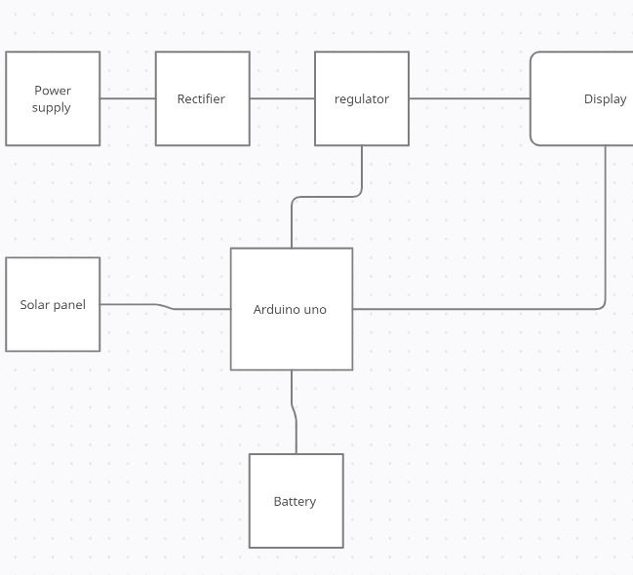
Mechanism

Slide 13
Budget
Name | Quantity | Price (AED)
Standard kit | 1 | 600
Solar Panel mount | 1 | 100
8 position DIP Switch | 1 | 4
Budget Breakdown

Slide 14

QUESTIONS

